Slide 1
Differential Timing Difference-in-Differences
UIUC ECON 474 Econometrics of Policy Evaluation

Slide 2

Overview
Last lecture of new content!
Next time: Review for Exam 2
Today:
Review 2$×$2 differene-in-differences
Differential timing difference-in-differences
Replicate: Cheng and Hoekstra (2013) Castle doctrine

Slide 3

Review: 2$×$2 diff-in-diff
The identifying assumption and checks supporting causal identification

Slide 4
Control represents counterfactual in diff-in-diff
Observational units have values that have a trend over time
Units: countries, cities, people, etc.
Values: trade flows, house prices, wages, etc.
Then, a treatment causes the unit onto a new trend
Cannot measure change in trend as ATE because experiment is not conducted in a lab
Complication: other things happen in the economy at the same time as treatment that could alter post-treatment trend
Require a control group following same pre- and post-treatment, non-treated potential outcome trend (parallel trends assumption)

Slide 5
Parallel trends assumption can be supported
The parallel trends assumption is about the counterfactual outcomes for treated units
Impossible to directly test
However, you can provide evidence supporting parallel trends by:
Producing an event study figure with parallel pre-trends
Finding null results with a lagged outcome variable

Slide 6
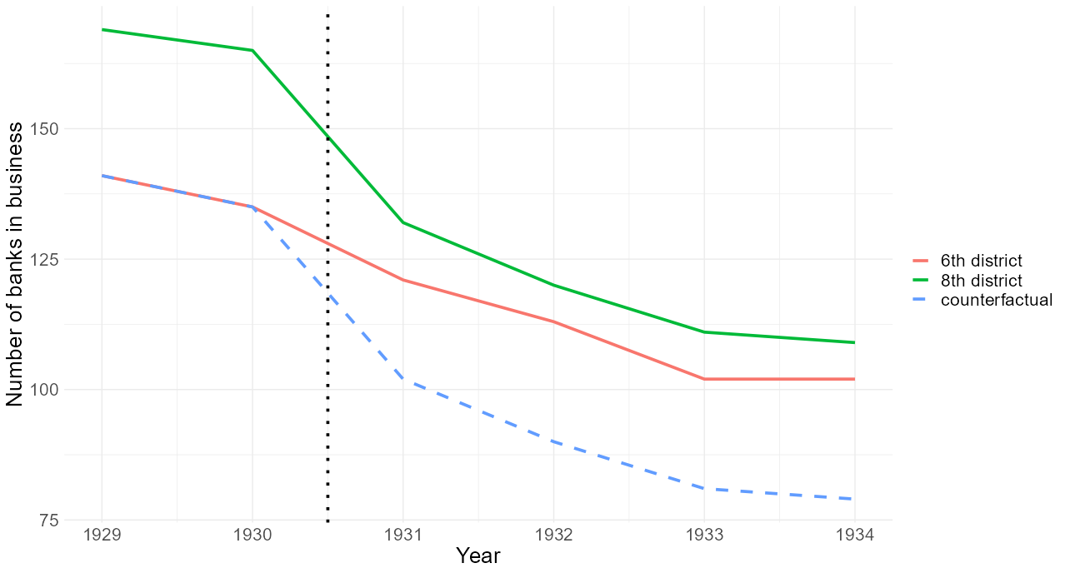
District 6 counterfactual outcome (dashed): $Y_{D=0}^{t=post}$

Slide 7
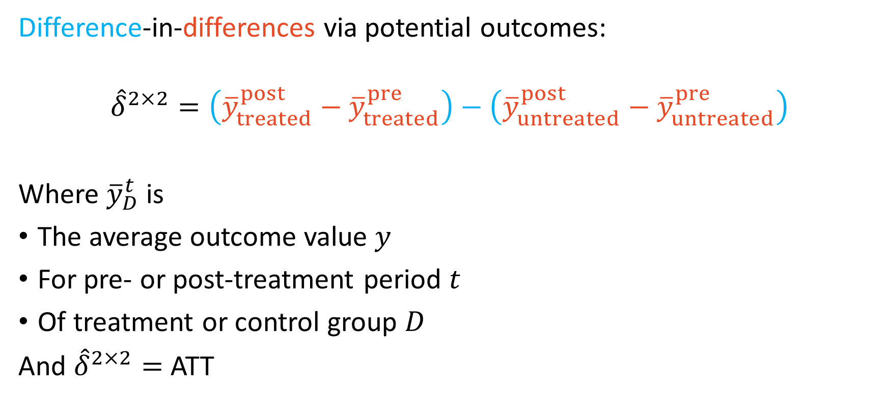
Difference-in-differences potential outcomes
Difference-in-differences via potential outcomes:
$${\hat{δ}}^{2×2}=\left({\overline{y}}_{treated}^{post}−{\overline{y}}_{treated}^{pre}\right)−\left({\overline{y}}_{untreated}^{post}−{\overline{y}}_{untreated}^{pre}\right)$$
Where ${\overline{y}}_{D}^{t}$ is
The average outcome value $y$
For pre- or post-treatment period $t$
Of treatment or control group $D$
And ${\hat{δ}}^{2×2}=$ ATT

Slide 8
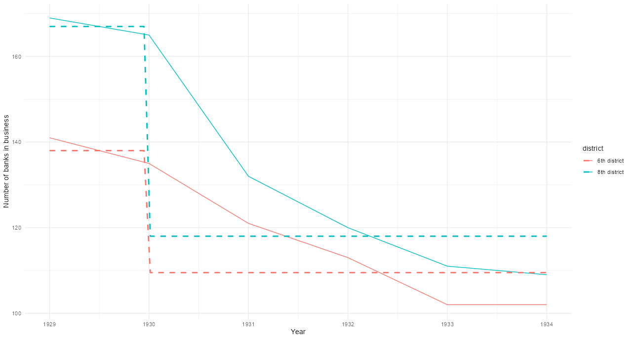
Visual ${\overline{y}}_{D∈\left\{treated, untreated\right\}}^{t∈\{pre, post\}}$

Slide 9
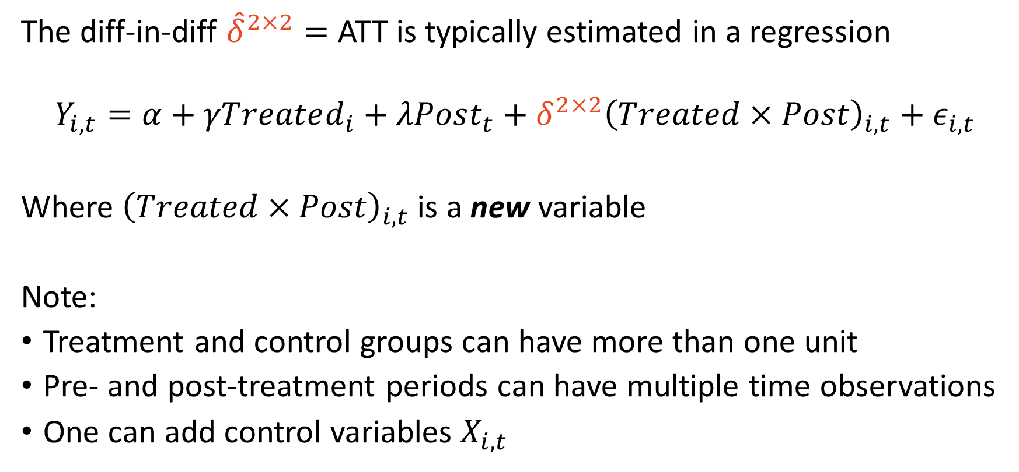
Estimating 2$×$2 difference-in-differences ATT
The diff-in-diff ${\hat{δ}}^{2×2}=$ ATT is typically estimated in a regression
$$Y_{i,t}=α+γTreated_{i}+λPost_{t}+δ^{2×2}{\left(Treated×Post\right)}_{i,t}+ε_{i,t}$$
Where ${\left(Treated×Post\right)}_{i,t}$ is a new variable
Note:
Treatment and control groups can have more than one unit
Pre- and post-treatment periods can have multiple time observations
One can add control variables $X_{i,t}$

Slide 10
Differential timing difference-in-differences
When units are treated in different time periods

Slide 11
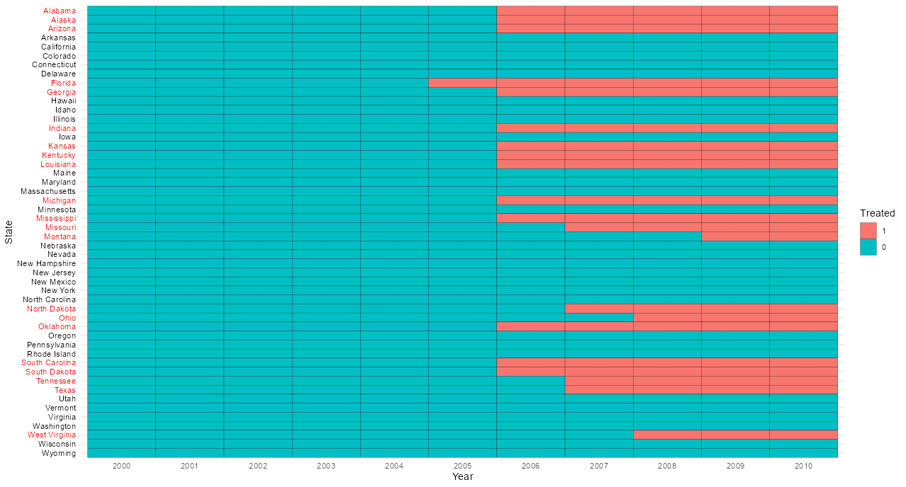

Slide 12
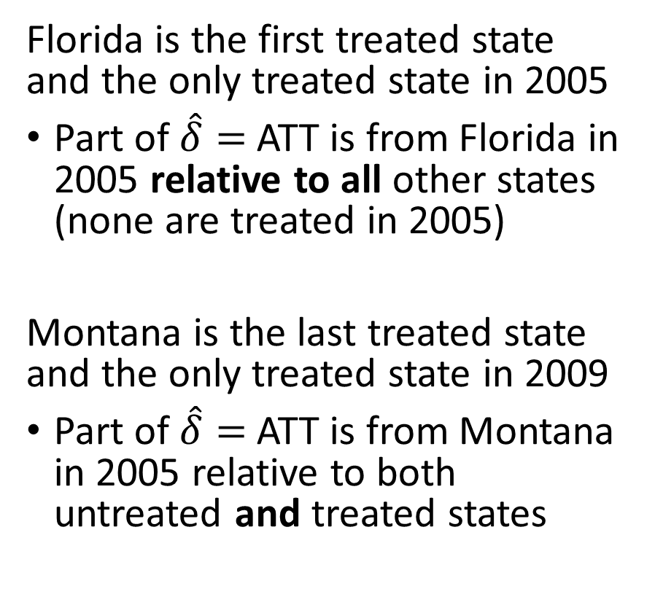
Differential timing DiD compares treated to treated
Florida is the first treated state and the only treated state in 2005
Part of $\hat{δ}=$ ATT is from Florida in 2005 relative to all other states (none are treated in 2005)
Montana is the last treated state and the only treated state in 2009
Part of $\hat{δ}=$ ATT is from Montana in 2005 relative to both untreated and treated states

Slide 13
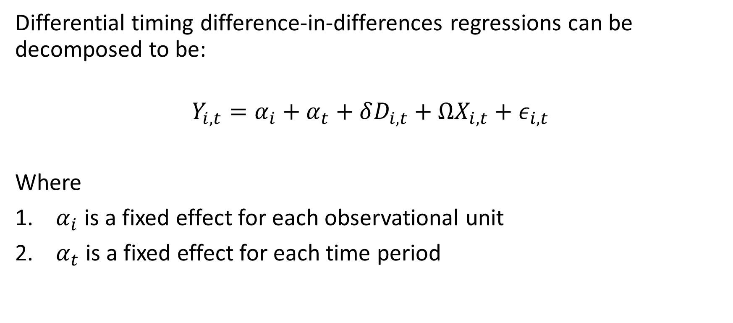
Two-way fixed effect (TWFE) regressions
Differential timing difference-in-differences regressions can be decomposed to be:
$$Y_{i,t}=α_{i}+α_{t}+δD_{i,t}+ΩX_{i,t}+ε_{i,t}$$
Where
$α_{i}$ is a fixed effect for each observational unit
$α_{t}$ is a fixed effect for each time period

Slide 14
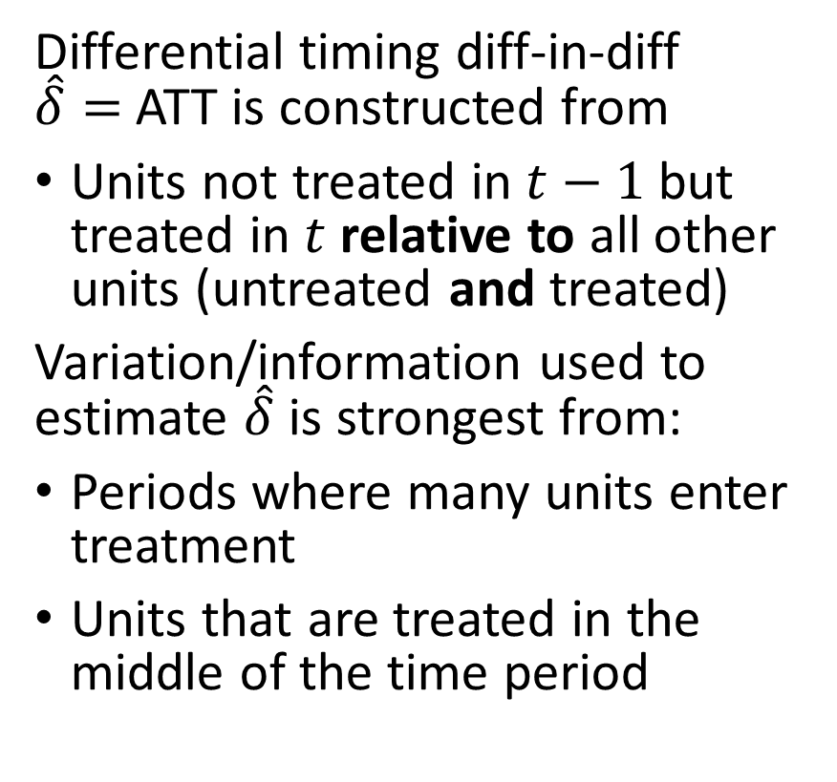
Differential timing DiD $\hat{δ}$ is a weighted average
Differential timing diff-in-diff $\hat{δ}=$ ATT is constructed from
Units not treated in $t−1$ but treated in $t$ relative to all other units (untreated and treated)
Variation/information used to estimate $\hat{δ}$ is strongest from:
Periods where many units enter treatment
Units that are treated in the middle of the time period

Slide 15
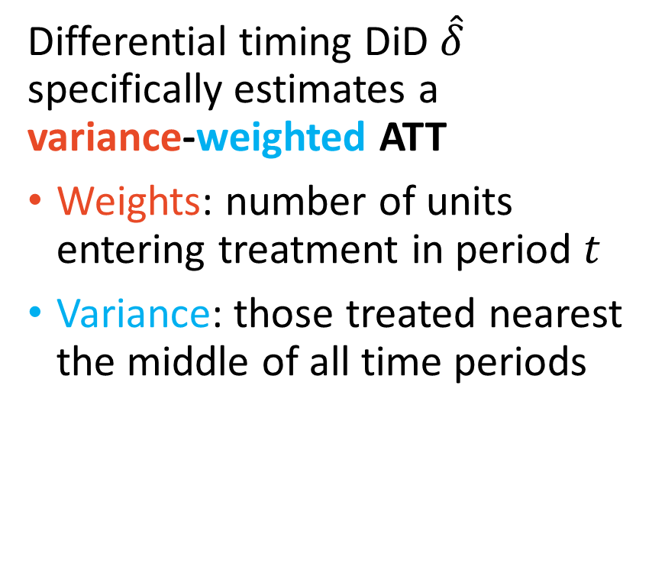
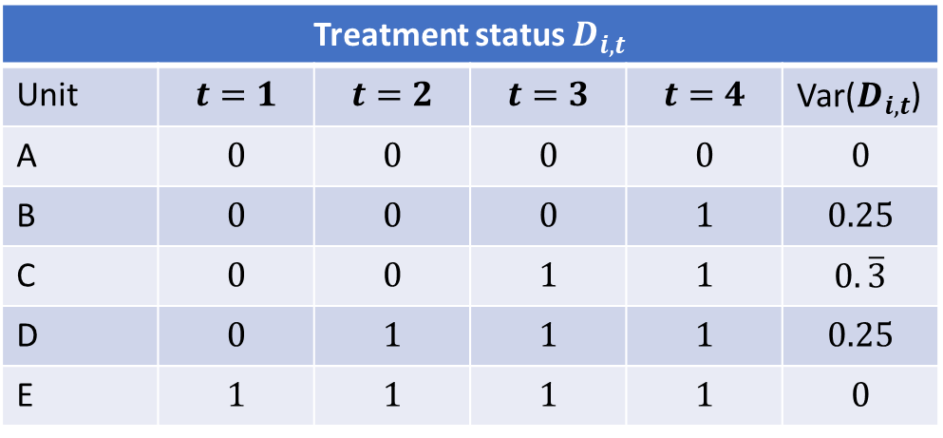
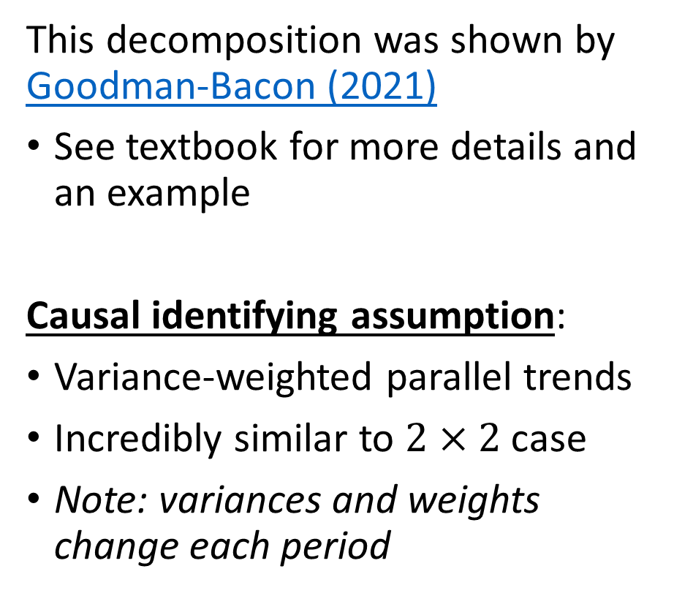
Differential timing DiD estimates are variance-weighted
Differential timing DiD $\hat{δ}$ specifically estimates a variance-weighted ATT
Weights: number of units entering treatment in period $t$
Variance: those treated nearest the middle of all time periods
This decomposition was shown by Goodman-Bacon (2021)
See textbook for more details and an example
Causal identifying assumption:
Variance-weighted parallel trends
Incredibly similar to $2×2$ case
Note: variances and weights change each period
Treatment status $D_{i,t}$
Unit | $$t=1$$ | $$t=2$$ | $$t=3$$ | $$t=4$$ | Var($D_{i,t}$)
A | $$0$$ | $$0$$ | $$0$$ | $$0$$ | $$0$$
B | $$0$$ | $$0$$ | $$0$$ | $$1$$ | $$0.25$$
C | $$0$$ | $$0$$ | $$1$$ | $$1$$ | $$0.\overline{3}$$
D | $$0$$ | $$1$$ | $$1$$ | $$1$$ | $$0.25$$
E | $$1$$ | $$1$$ | $$1$$ | $$1$$ | $$0$$

Slide 16
Cheng and Hoekstra (2013) “Does Strengthening Self-Defense Law Deter Crime or Escalate Violence? Evidence from Expansions to Castle Doctrine."
Legalized lethal self-defense

Slide 17
Cheng and Hoekstra (2013) overview
Castle doctrine: you can use lethal self-defense in your home
Between 2000-2010, 21 states extended the right to public places
Ex) the murder of Trayvon Martin (discussed earlier in the semester) was considered to be legal under Florida’s expanded castle doctrine
Research question:
Does Strengthening Self-Defense Law Deter Crime or Escalate Violence?

Slide 18
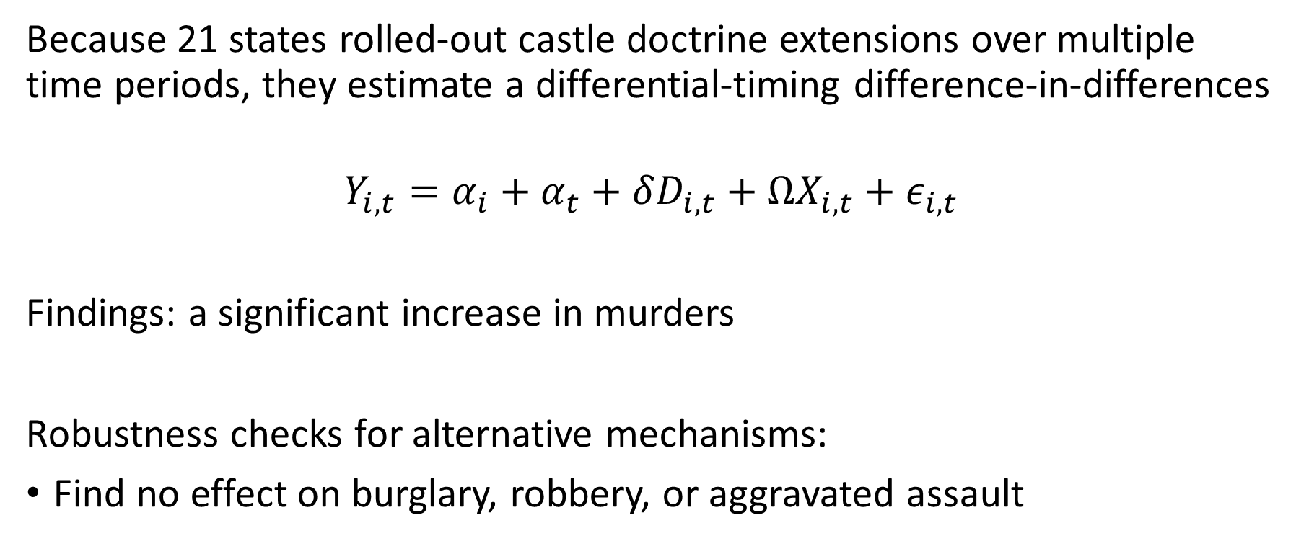
Cheng and Hoekstra (2013) method and findings
Because 21 states rolled-out castle doctrine extensions over multiple time periods, they estimate a differential-timing difference-in-differences
$$Y_{i,t}=α_{i}+α_{t}+δD_{i,t}+ΩX_{i,t}+ε_{i,t}$$
Findings: a significant increase in murders
Robustness checks for alternative mechanisms:
Find no effect on burglary, robbery, or aggravated assault

Slide 19
Time to replicate!

